Slide 1
Azure AD for non-developers
Rory Braybrook
Microsoft Identity Architect
Microsoft MVP
@rbrayb

Slide 2
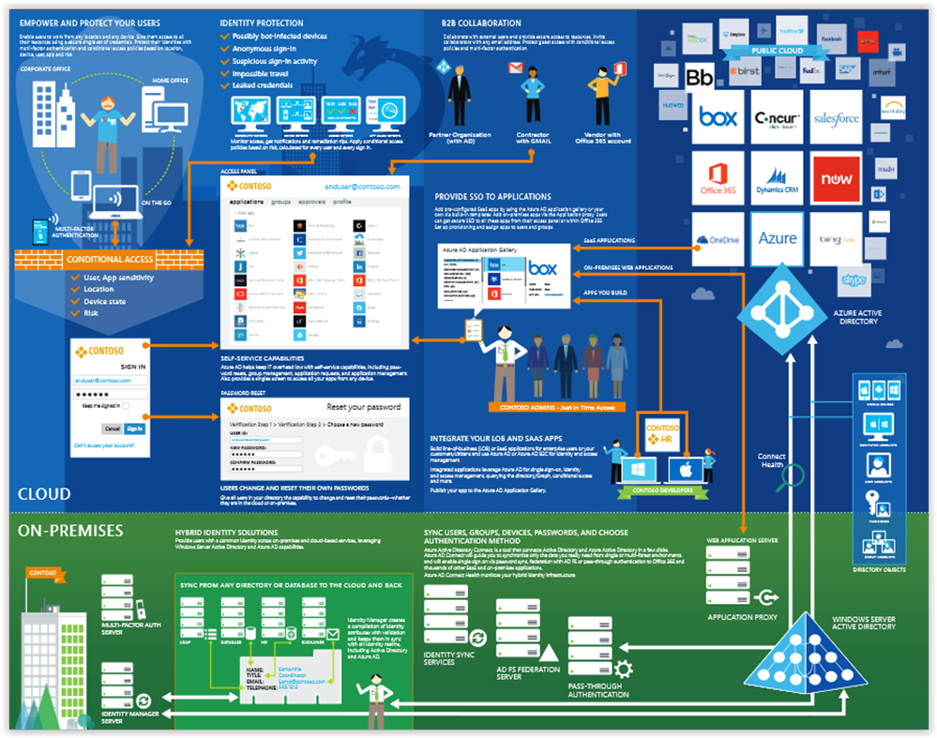

Slide 3
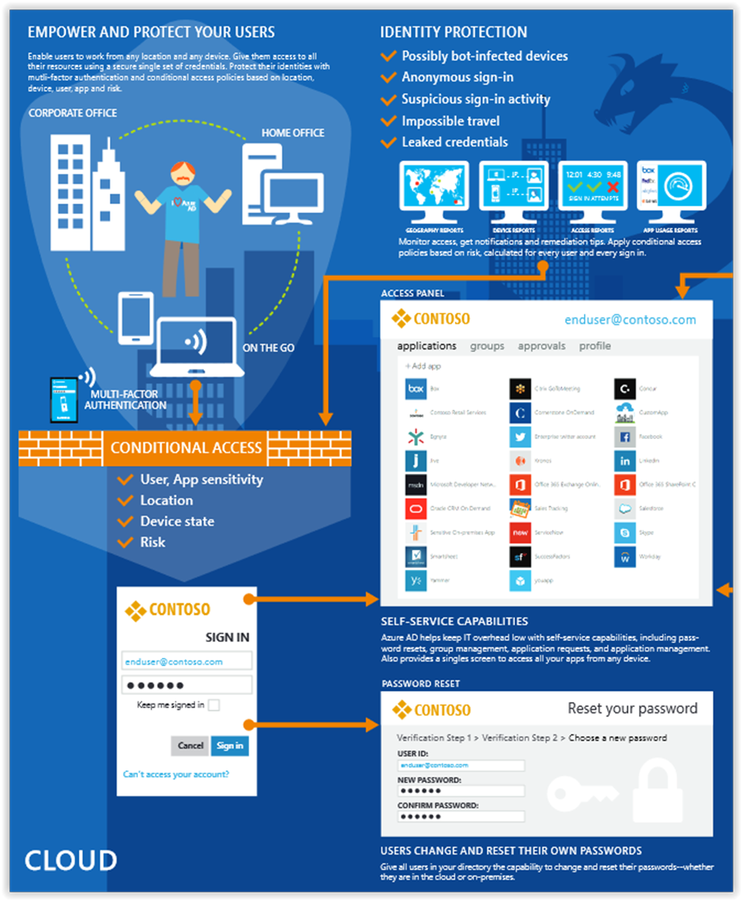

Slide 4
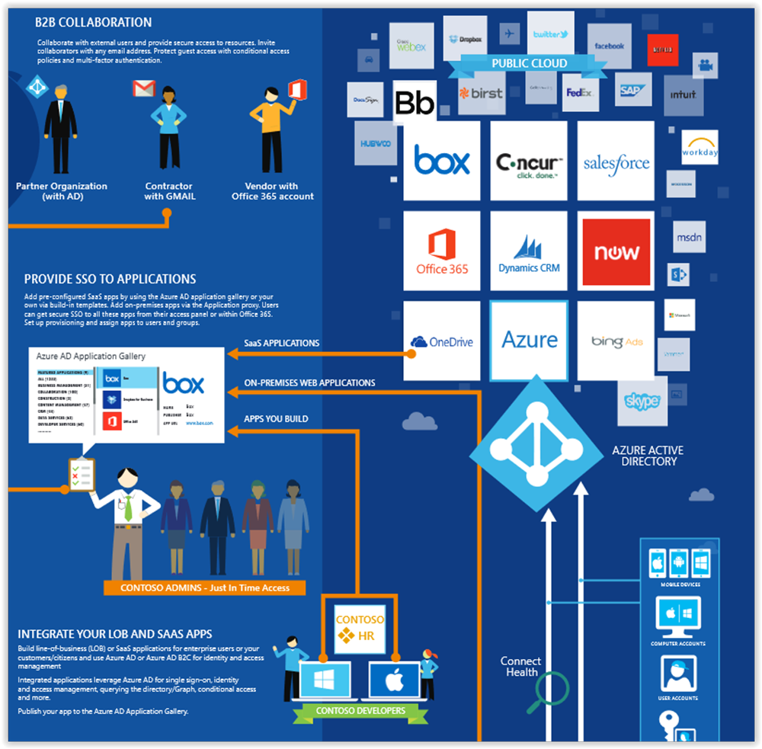

Slide 5
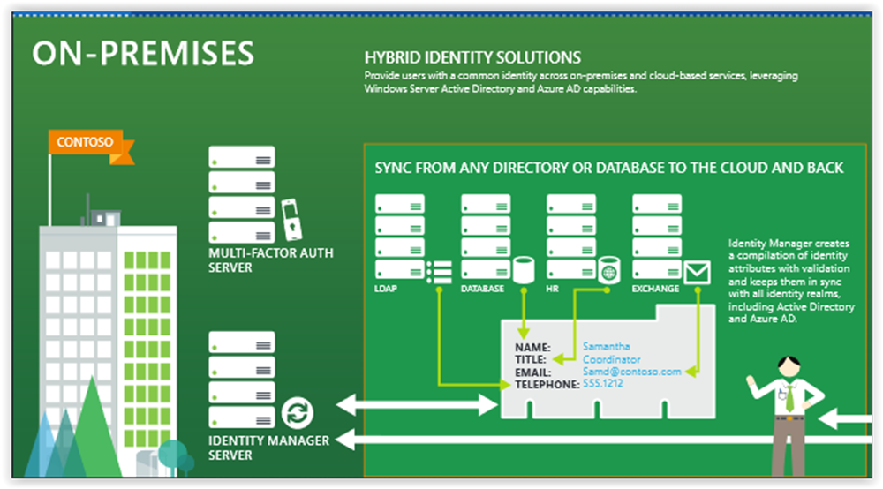

Slide 6
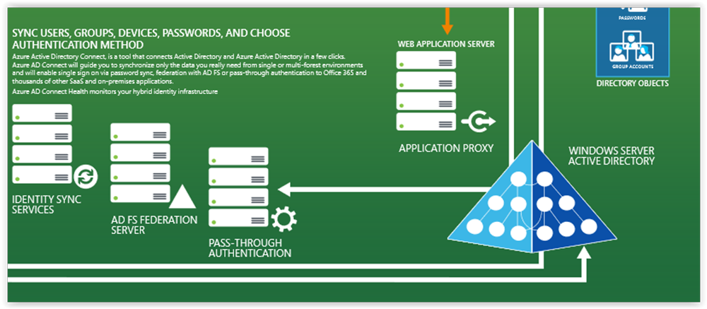

Slide 7
Pricing
Azure Active Directory Free. Provides user and group management, on-premises directory synchronization, basic reports, self-service password change.
Azure Active Directory Premium P1. In addition to the Free features, P1 also lets your hybrid users access both on-premises and cloud resources. It also supports advanced administration, such as dynamic groups, self-service group management, and cloud write-back capabilities, which allow self-service password reset for your on-premises users.
Active Directory Business-to-Customer (B2C).

Slide 8
Pricing
Azure Active Directory Premium P2. In addition to the Free and P1 features, P2 also offers Azure Active Directory Identity Protection to help provide risk-based Conditional Access to your apps and critical company data and Privileged Identity Management to help discover, restrict, and monitor administrators and their access to resources and to provide just-in-time access when needed.
"Pay as you go" feature licenses. You can also get additional feature licenses, such as Azure Active Directory Business-to-Customer (B2C).

Slide 9
Features
Application management – AD proxy, MyApps (Access panel), SaaS
Authentication - self-service password reset, Multi-Factor Authentication, custom banned password list, smart lockout
B2B – guest users, invite, federation, Google
B2C – customer self-service
Conditional access – access rules
Identity platform – set of libraries for dev.
Device Management – Intune – mobile

Slide 10
Features
Domain services – DC aaS
Enterprise users – SAML
Hybrid identity – AAD Connect, Connect Health
Identity protection – ML to detect potential vulnerabilities
Privileged identity management (PIM) – manage admins.
Reports and monitoring

Slide 11
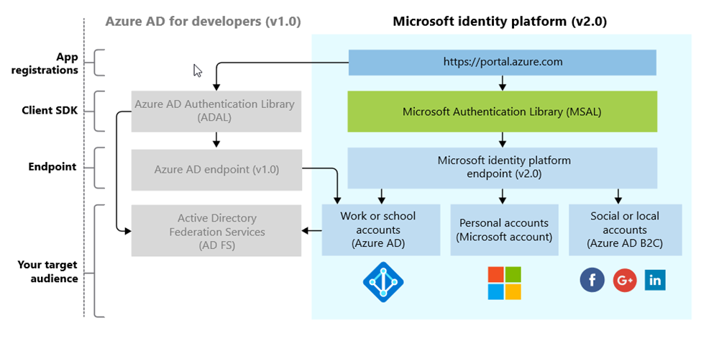
The Microsoft Identity Platform (not the Product!)

Slide 12






Microsoft Authentication Libraries (MSAL)
Generally Available:
GA
GA
GA
GA
GA
GA
JavaScript
.NET
Android
iOS/macOS
Production Supported Public Preview:
PREVIEW
PREVIEW
Java
Python

Slide 14
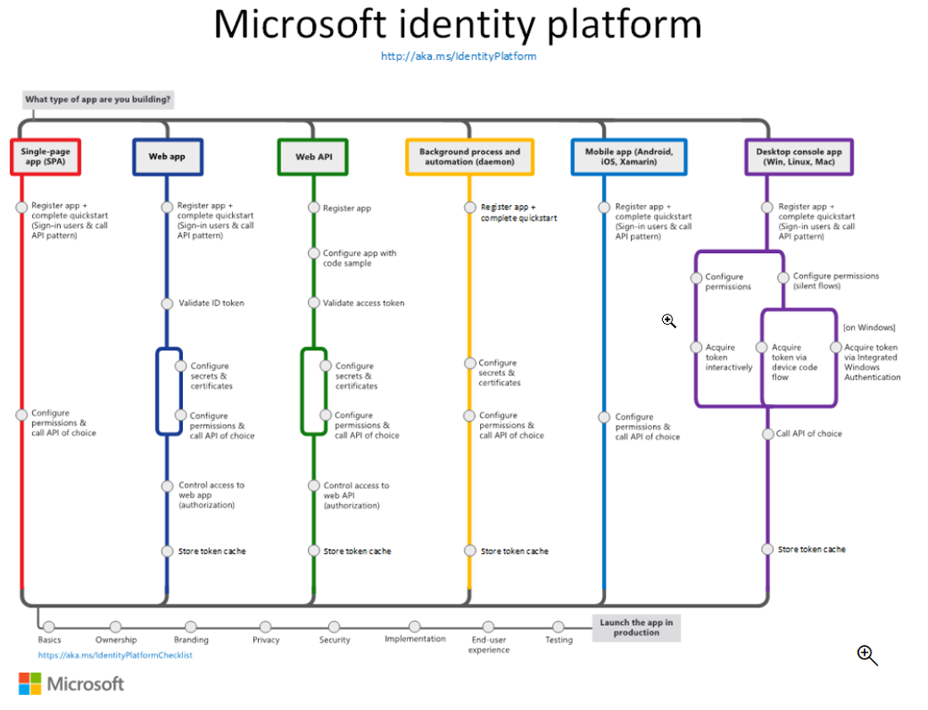

Slide 15
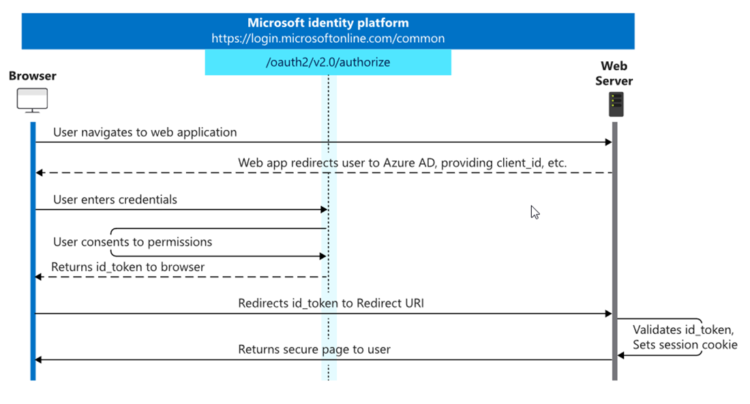
OpenID Connect

Slide 16
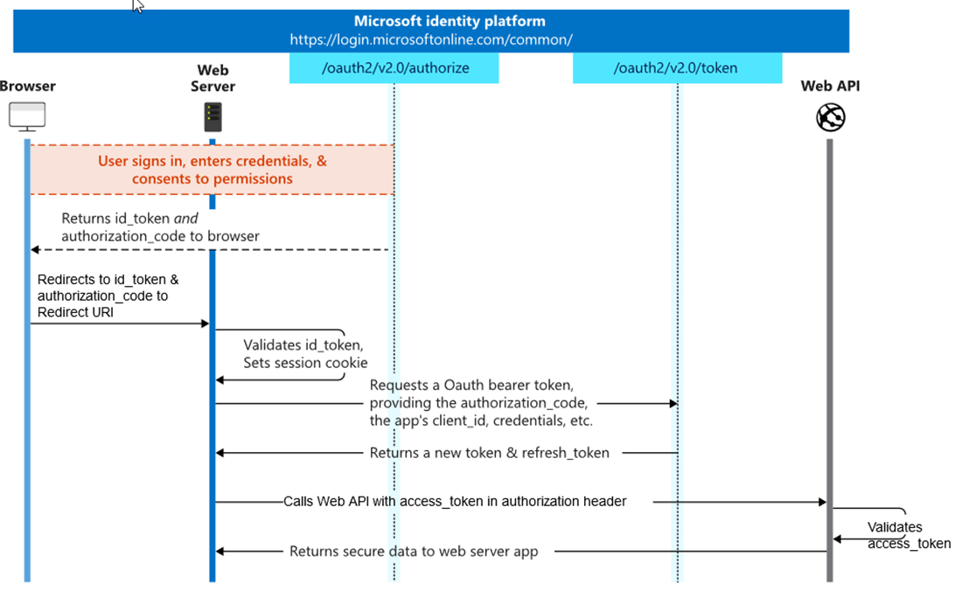
OAuth 2.0

Slide 17
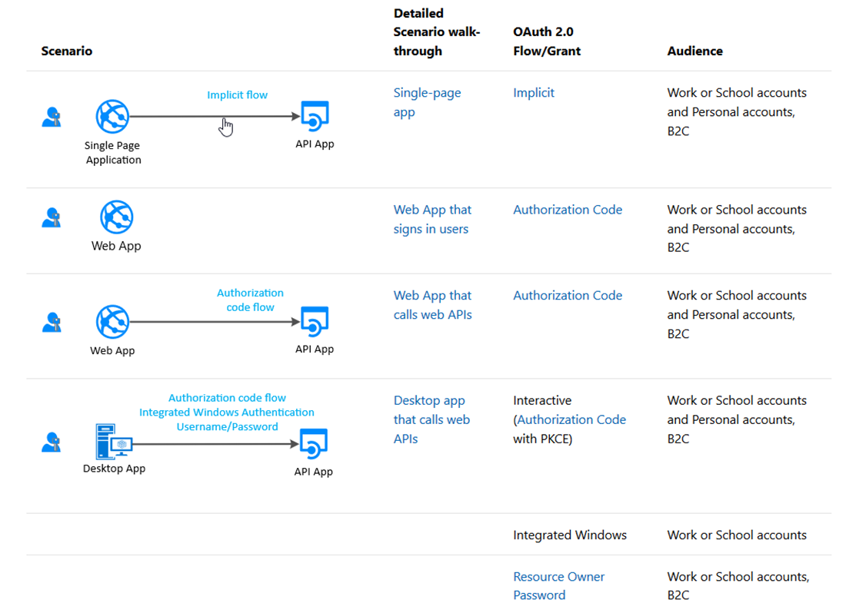
Scenarios

Slide 18
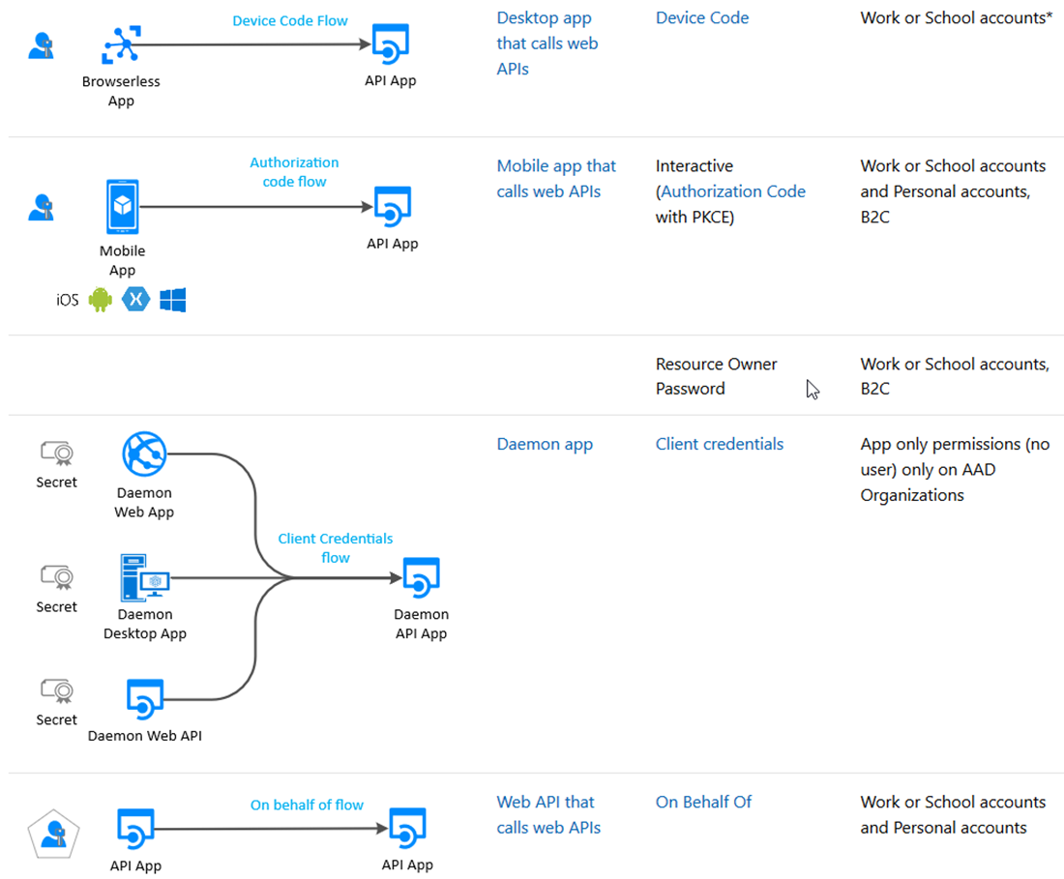
Scenarios

Slide 19
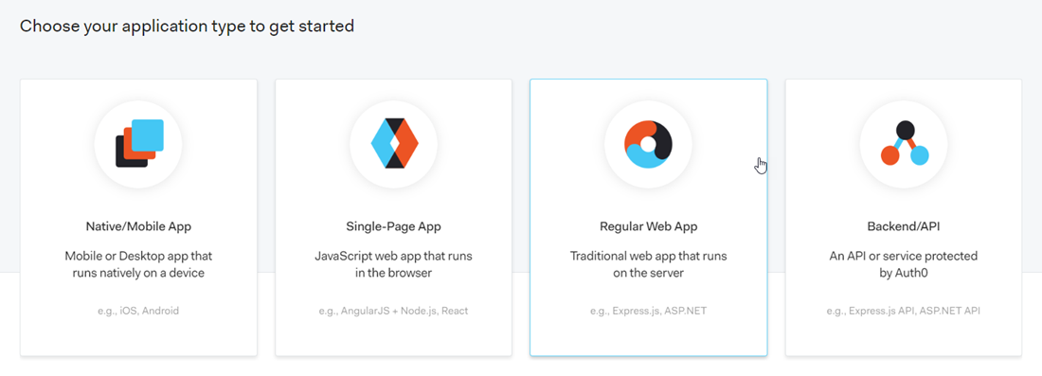
The Format – Auth0

Slide 20
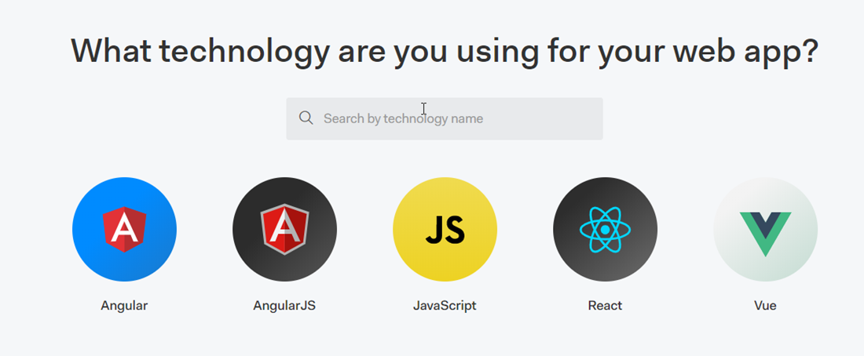
The Format – Auth0

Slide 21
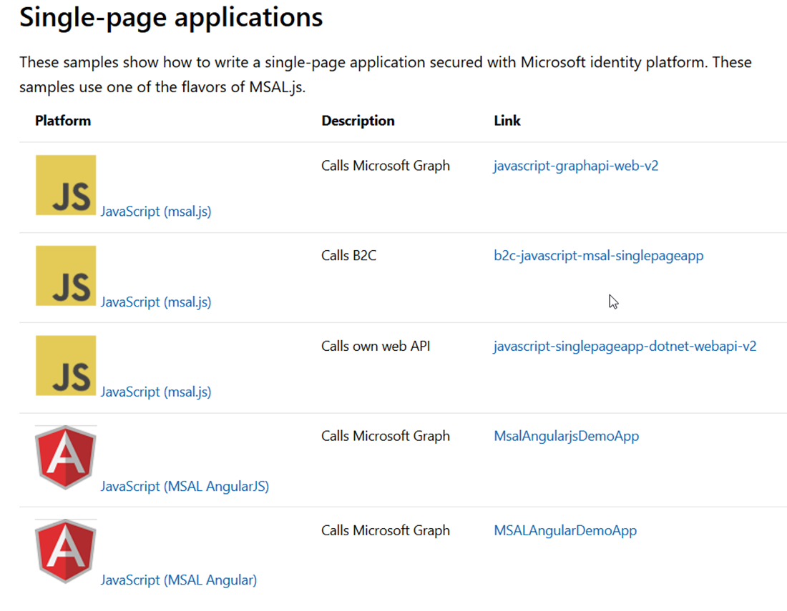
The Format – SPA

Slide 22
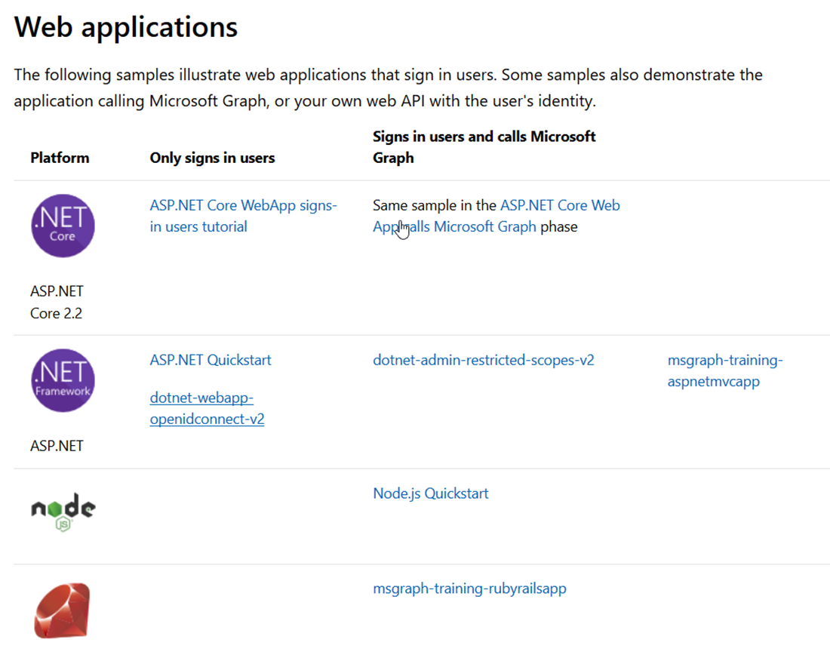
The Format – Web

Slide 23
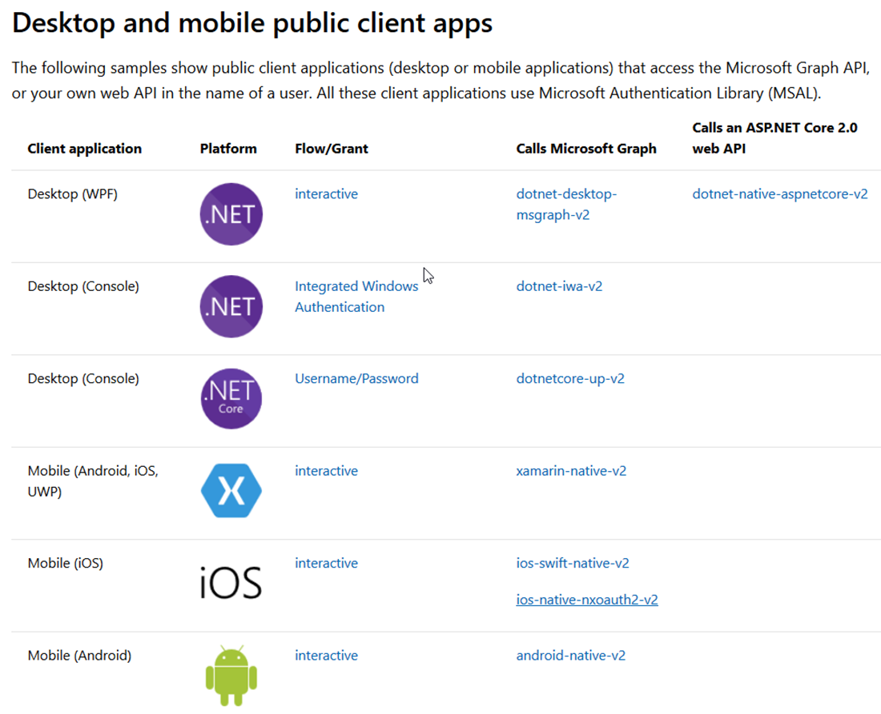
The Format – Native (User)

Slide 24
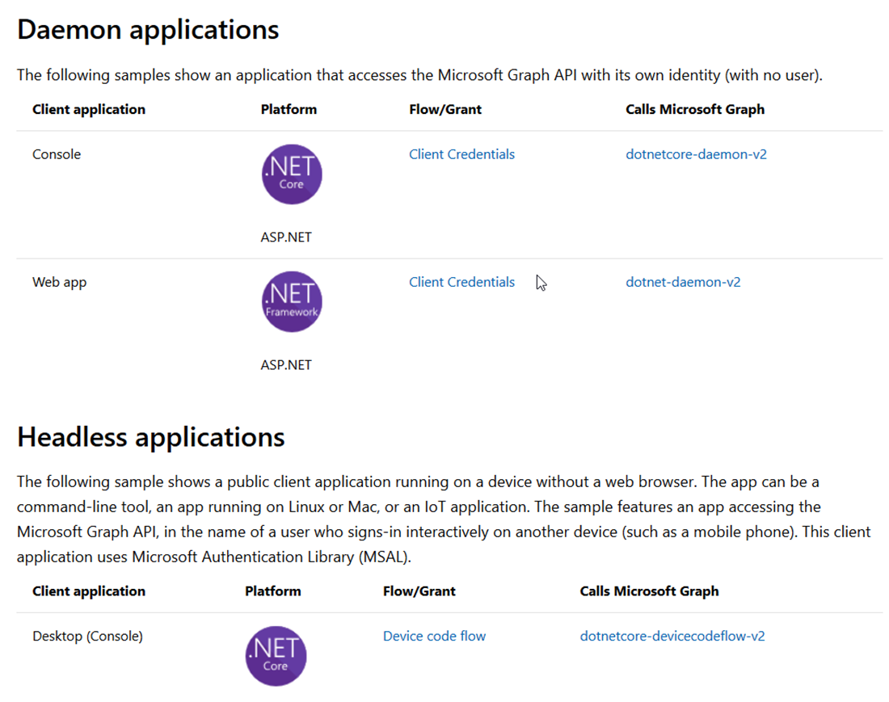
The Format – Native (Application)

Slide 25
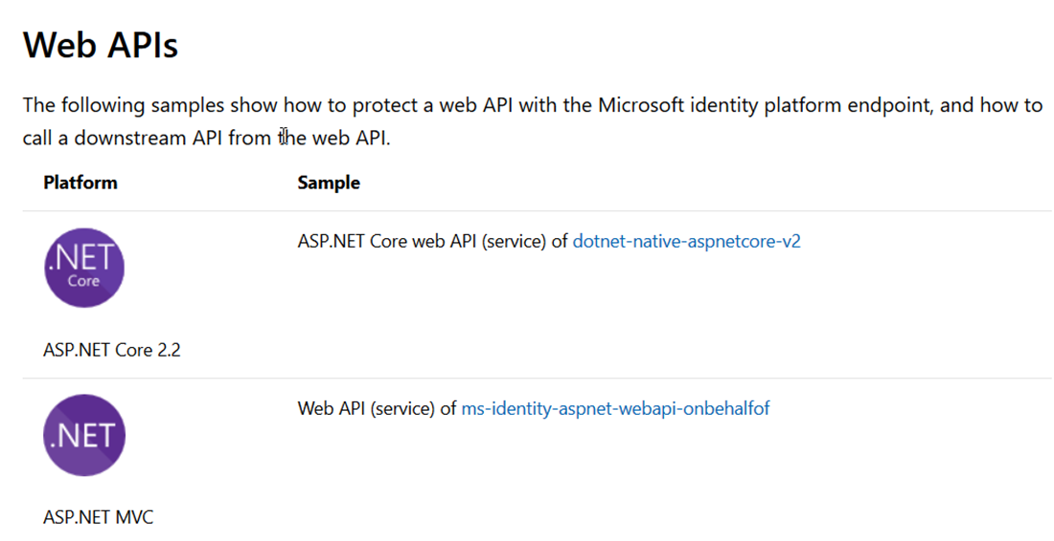
The Format – Web API

Slide 26
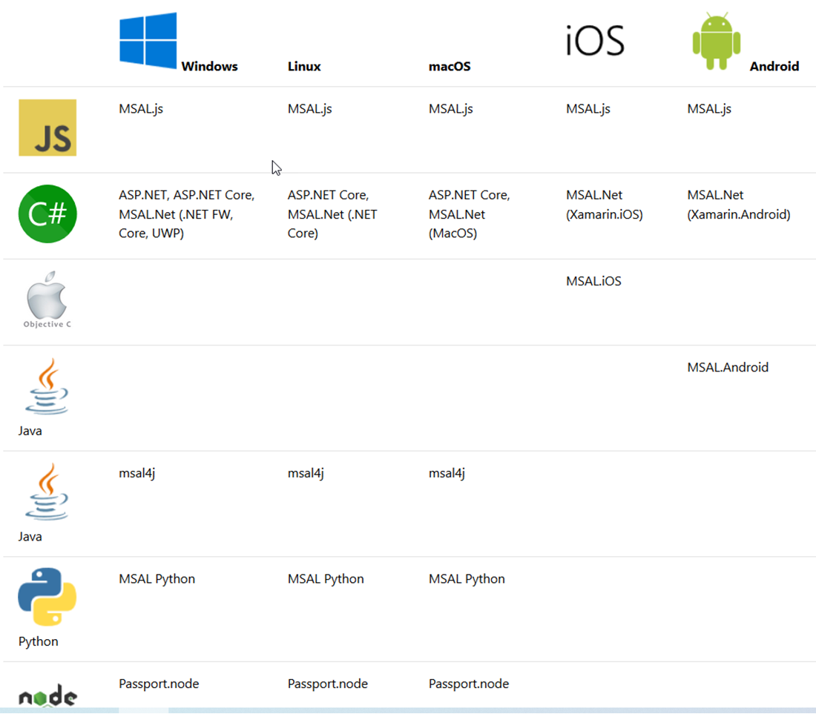
The OS

Slide 27
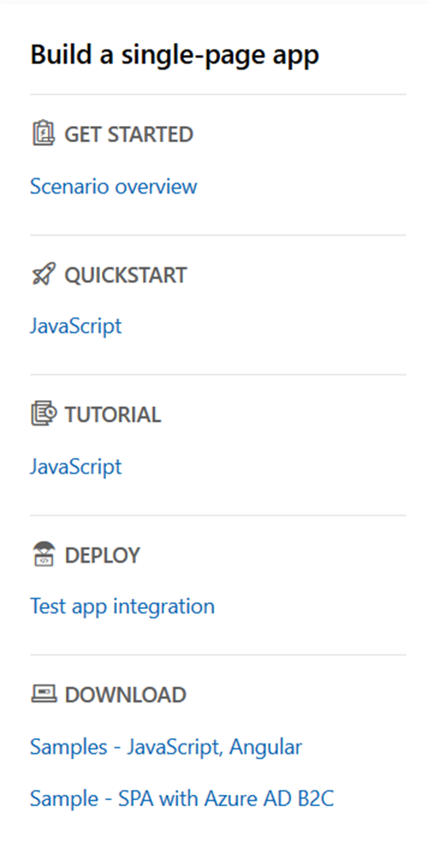
The Menu

Slide 28
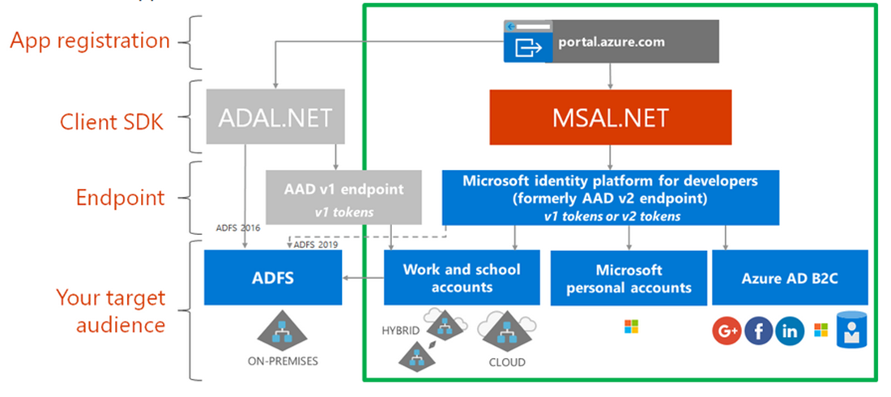
ADAL - MSAL

Slide 29
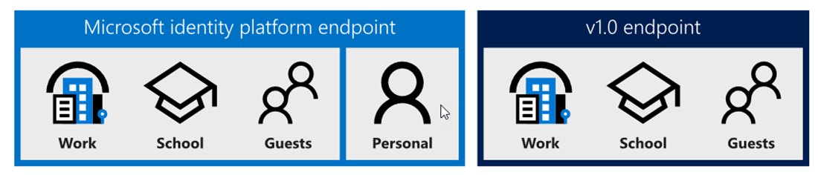
The Endpoints

Slide 30
Types of tenant
You can restrict the types available by modifying the authority URL.
https://login.microsoftonline.com/common/v2.0
The default, allows any account
https://login.microsoftonline.com/organizations/v2.0
Allow only Azure AD/Office 365 accounts
https://login.microsoftonline.com/consumers/v2.0
Allow only personal MS accounts
https://login.microsoftonline.com/{tenant-id}/v2.0
Allow only a specific Azure AD tenant

Slide 31
Resources / scopes
ADAL
Resource URI
https://graph.microsoft.com
MSAL
Scope
https://graph.microsoft.com/Calendars.Read
Scope=Calendars.Read

Slide 32
The rest
MSAL - ADFS
MSAL connects to Azure AD, which is federated with AD FS
MSAL connects directly to AD FS (Server 2019) (Azure Stack)
Can use ADAL (Samples available)
MSAL – Azure AD B2C
JS
.NET
Samples available

Slide 33
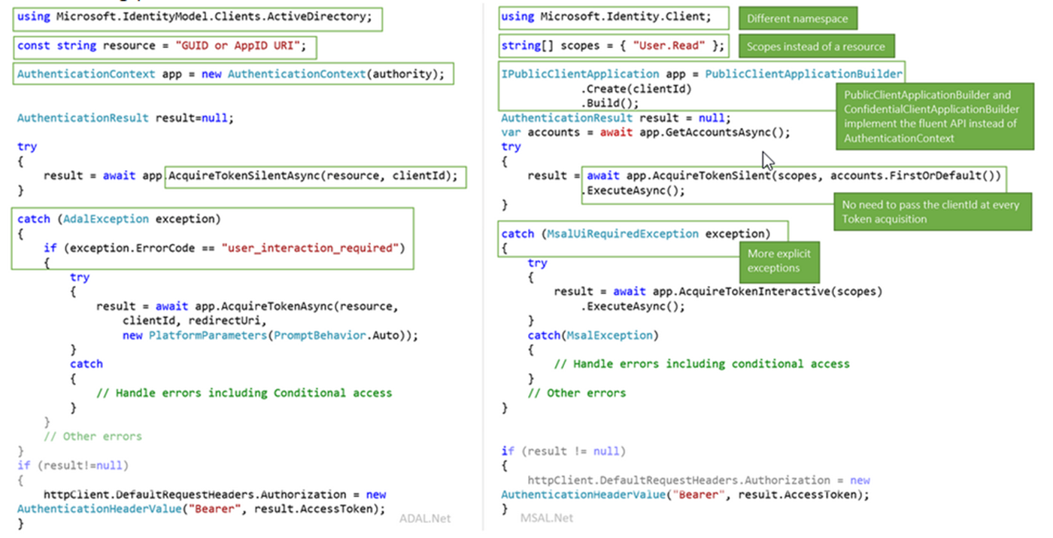
ADAL – MSAL - code

Slide 34
The Demo
The old way
Connected Services
.NET Core B2C
New application registration
Samples

Slide 35
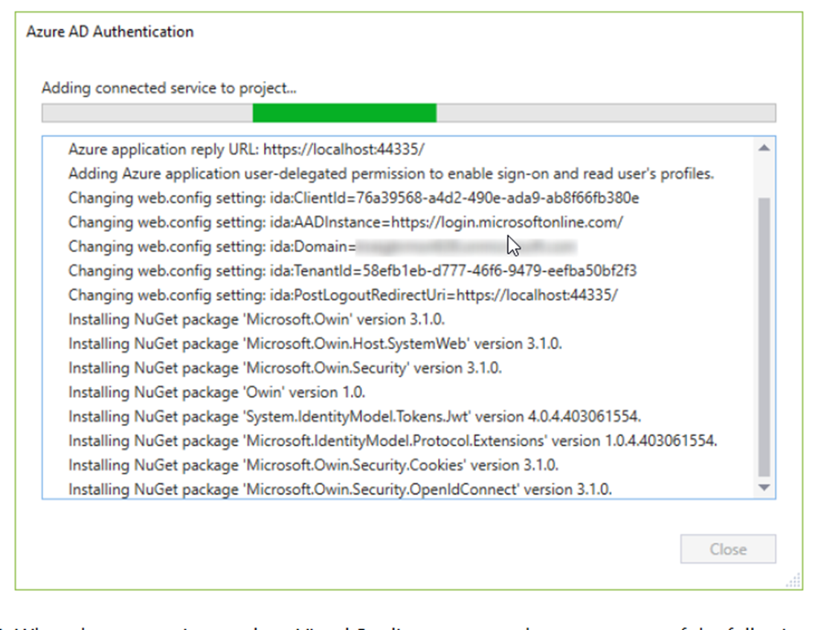
Connected Services

Slide 36
It’s EASY and you get stuff for FREE
It’s easy:
Register your app
Use a quickstart
Request permission to data
The rest comes automatically, with no extra code:
single sign on, token management, passwordless, conditional access

Slide 37
Best practice for single sign on
Always try the silent token acquisition before attempting interactive token acquisition!
This simple pattern enables SSO and handling IT policy.
try
{
result = await app.AcquireTokenSilent(scopes, account).ExecuteAsync();
}
catch(MsalUiRequiredException ex)
{
result = await app.AcquireToken(scopes, account).ExecuteAsync();
}

Slide 38
Best practices for secure authentication
Build your solutions by using libraries (MSAL, .NET middleware)
Clients don’t inspect access tokens (only for intended API)
Don’t store login names and passwords. Use MSAL/B2C
Apps shouldn’t handle raw passwords (avoid ROPC)
Confidential clients (daemon, web services) should use certs
Best practices: aka.ms/msidbestpractice

Slide 39
Best practices for updating to MSAL
Write your new apps using MSAL
Update your ADAL apps to MSAL to get the latest innovation
Guides:
aka.ms/UpdateToMSALjs
aka.ms/UpdateToMSALNet
aka.ms/UpdateToMSALAndroid
aka.ms/UpdateToMSALiOSmacOS

Slide 40
Microsoft Authentication Libraries (MSAL)
Generally Available:
GA
GA
GA
GA
GA
GA
JavaScript
.NET
Android
iOS/macOS
Production Supported Public Preview:
PREVIEW
PREVIEW
Java
Python

Slide 41
Best Practices
Follow the Golden Rules for tokens
Create the best user experience with scopes
Use Roles or Groups
Enable Provisioning
Protect APIs
Protect Services
Protect your apps

Slide 42
Golden Rules for Tokens
Use tokens only for their intended function
ID Tokens identify the user to the application
Access tokens authorize the app for a range of operation for an API
Never mess with someone else’s tokens
Apps do not look at access tokens
APIs never use ID Tokens for authorization
APIs never accept Access Tokens for other APIs
Cache the tokens appropriately
MSAL handles this automatically
Check for error classes instead of search for specific error codes

Slide 43
References
https://azure.microsoft.com/mediahandler/files/resourcefiles/cloud-identity-and-access-management/Cloud_Identity_and_Access_Management_infographic.pdf/
https://docs.microsoft.com/en-us/azure/active-directory/develop/
https://docs.microsoft.com/en-us/azure/active-directory/develop/identity-platform-integration-checklist
https://www.youtube.com/watch?v=y_fgJAatVhk&feature=youtu.be
https://medium.com/the-new-control-plane
https://aka.ms/msidplatform
https://developer.microsoft.com/en-us/identity
https://myignite.techcommunity.microsoft.com/sessions/81635

Slide 44


